Slide 1


ADVANCED IDE BASED FAULT DETECTION AND MANAGEMENT FOR 3-PHASE TRANSMISSION LINES
Presented by:
A LOKESH (192312609)
S HARSHIT (192312612)
J M SWETHA (192312403)
Supervisor:
Dr. D SHEELA
ECA1505-TRANSMISSION LINES AND WAVEGUIDES FOR 6G ROLLOUT APPLICATION
Institution:
SIMATS ENGINEERING Date: [14/07/2025]

Slide 2
Introduction
3-phase transmission lines are essential for reliable power delivery
Faults (L-G, L-L, L-L-G, 3-phase) cause disruption and damage
This project uses IDE and microcontrollers for real-time fault management
Goal: Detect and manage faults efficiently using embedded systems

Slide 3
Hardware Components
Transformer – voltage level adjustment for safe detection
Arduino Uno – processes sensor input and runs detection logic
ESP32 (NodeMCU) – enables wireless communication and cloud integration
LEDs (Red, Blue, Green) – indicate fault type and system status
16x2 LCD Display – real-time status and fault messages
Relay Module (single channel) – controls circuit connection/disconnection during faults
Neo 6M GPS Module - used to navigate the point of error.

Slide 4
Architecture / Configuration
Transformer steps down voltage for safe sensing
Arduino collects current/voltage data and executes logic
ESP32 sends data to cloud or mobile interface
LEDs visually indicate specific fault types
LCD shows current phase status and alerts
Relay disconnects faulty line to protect the system

Slide 5
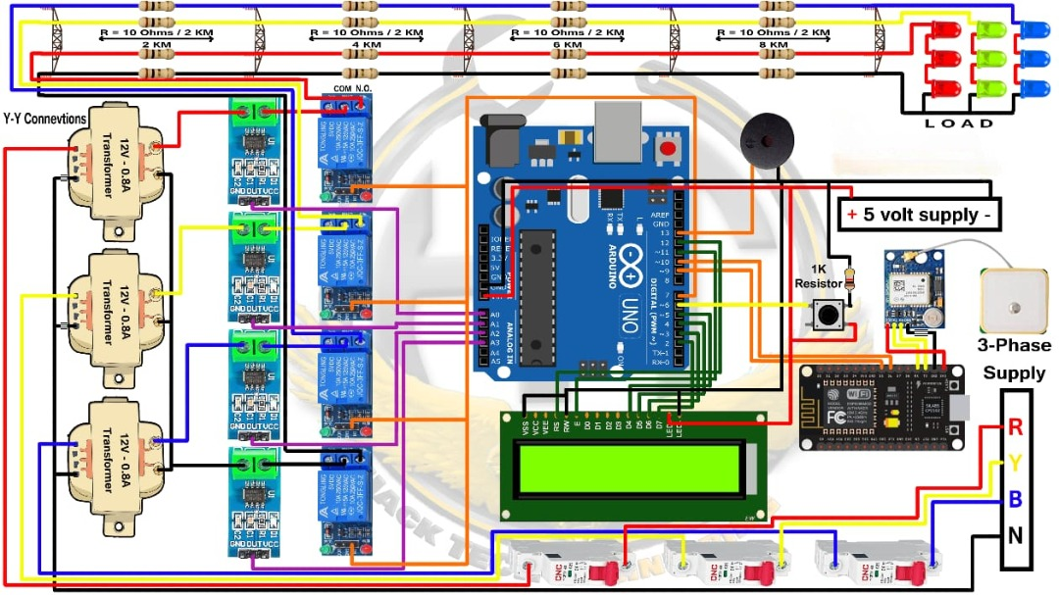
Circuit Diagram

Slide 6
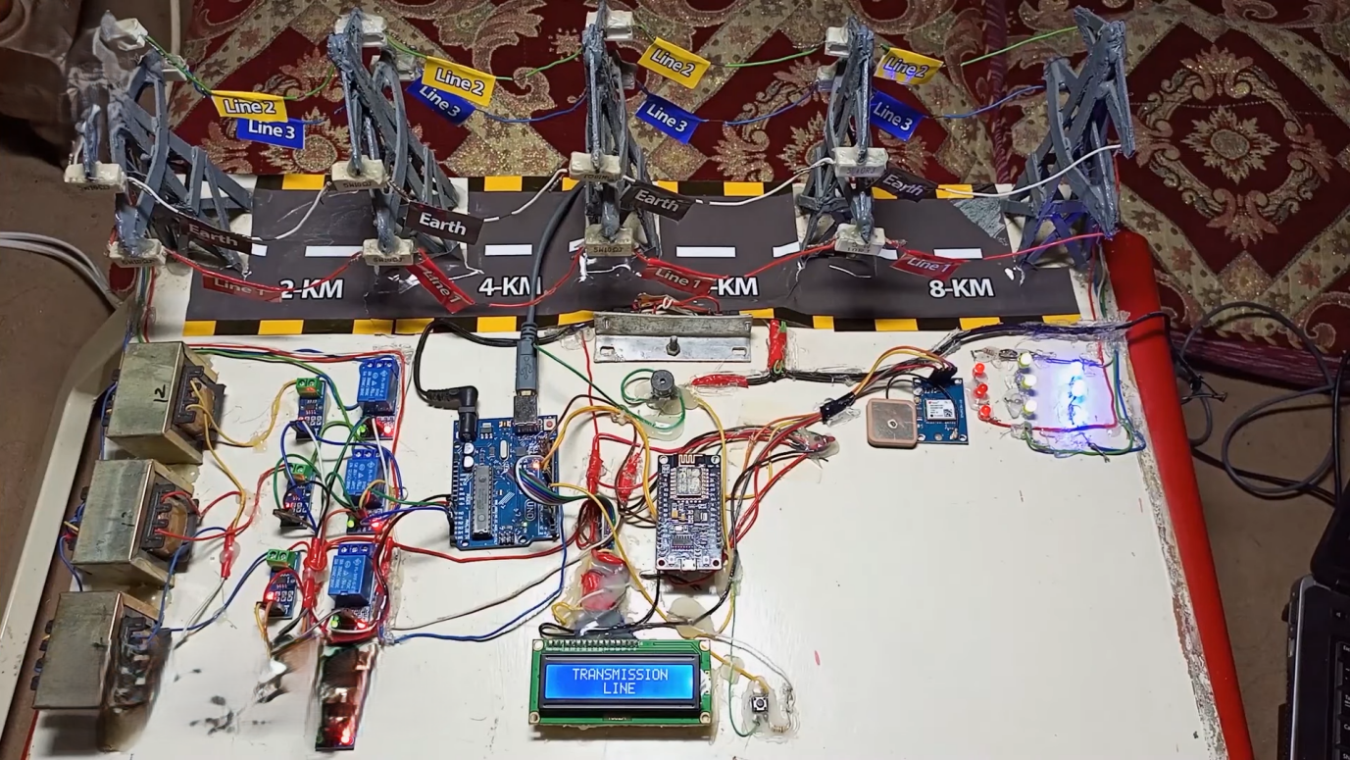
Hardware Implementation

Slide 7
Challenges and Solutions
Signal Noise: Mitigated using filtering and proper grounding
Timing Delays: Solved by optimizing code and loop timing
Hardware Integration: Resolved using modular circuit design
Cloud Communication: Ensured via stable ESP32 setup and protocols

Slide 8
Application
Power grid and substation fault monitoring
Educational labs for electrical engineering
Smart grid and SCADA system enhancement
Remote fault detection with mobile alerts (via ESP32)

Slide 9
Conclusion
Efficient real-time fault detection system designed and tested
Arduino and ESP32 ensure automation and connectivity
Helps reduce outage time and improves safety
Future: Expand to multi-line monitoring and AI-based prediction

Slide 10
THANK YOU

